Slide 1
Beyond Sigmoids: the NetTide Model for Social Network Growth and its Applications
Chengxi Zang, Peng Cui, Christos Faloutsos
Tsinghua University
Notes:
Good morning everyone, this is Chengxi Zang from Tsinghua Univ. At first, I must thanks the invitation of the **. Thanks for your kindness and the hospitality. Here, I am going to present a work published in KDD’16 San Francisco, named Beyond Sigmoids: the NetTide Model…

Slide 2
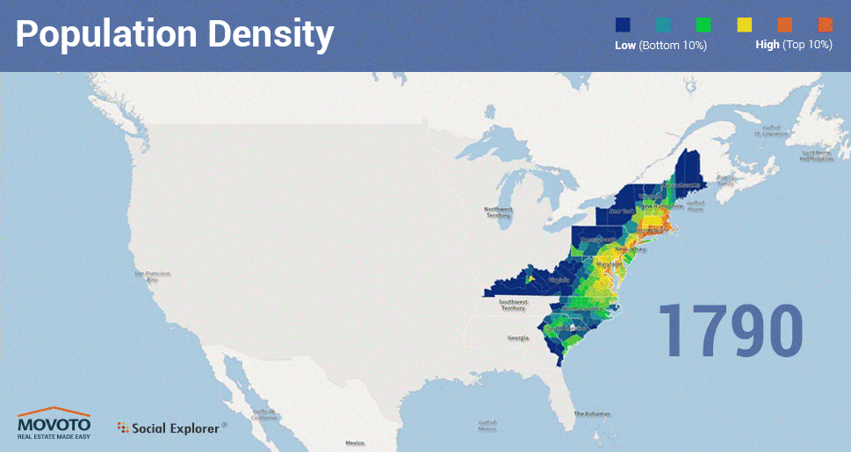
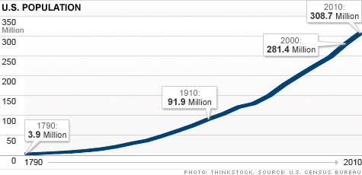
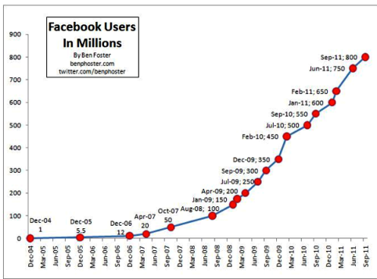
Growth Phenomenon
Notes:
SN growth is a ubiquitous phenomenon both in physical society and online social media. For example, the growth of USA population, the growth of facebook users, the growth of WeChat微信 users， and etc. The understanding of the SN growth is of vital importance, for example: the growth of social products, provisioning, social implications of policy changes, and so on so forth

Slide 3
Problem: How do n(t) and e(t) grow over time?
n(t): the number of nodes.
e(t): the number of edges.
E.g.:
How many members will have next month?
How many friendship links will have next year?
Notes:
Mathematically, the focus of this paper is to answer following questions on social network growth. How does the number of nodes nt grow over time? How does the number of links et grow over time?
For instances, how many members will Twitter have next month? How many friendship links will WeChat have next year?

Slide 4
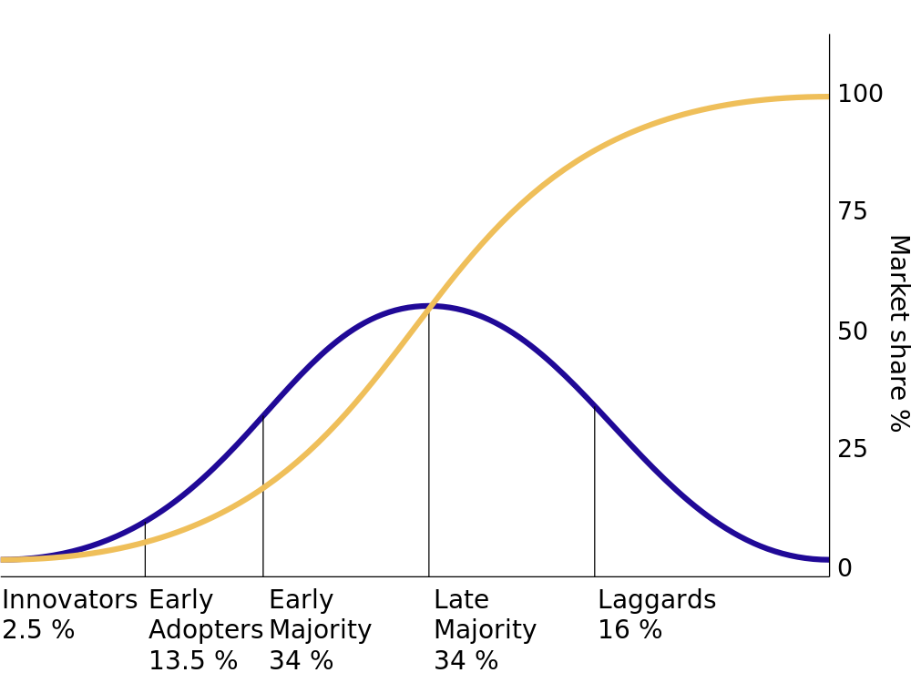
Past assumptions on n(t)
n(t): the number of nodes.
Past assumptions:
Accept it, that’s all: Kumar KDD’06, Watts Science’06, Leskovec TKDD’07 , KDD’ 08
Uniform: Barabasi Science’99, Bianconi EPL’01, Leskovec TKDD’07
Exponential: Huberman Nature’99
Sigmoid(S-shape): Bass MS’69, 04 Anderson et al. Book’1992,
C
C/2
Exponential:
0
Notes:
As for the question 1, how does n(t) grow over time, previous assumptions can be classified into following four categories:1 just accept the empirical nt as the basis for the further study; 2uniform growth ,like the celebrated barabasi model in Scien99； 3Exponential growth, and 4Sigmoid. Among them, the most adopted model is the bass model, which features S-shaped curve with exponential early growth. However, we find the reality disagrees with all the previous assumptions.

Slide 5
Past assumptions on e(t)
e(t): the number of edges.
Past assumptions:
Few.
Notes:
As for the question 2, None of previous studies know how et grow over time, although its is also important, well connected nodes in say, facebook are less inclined to churn, well connected neurons in a brain indicate resistance to Alzheimer’s disease, etc.

Slide 6
Big-Data-Driven
WeChat 2011/1-2013/1 300M nodes, 4.75B links
ArXiv 1992/3-2002/3 17k nodes, 2.4M links
Enron 1998/1-2002/7 86K nodes, 600K links
Weibo 2006 165K nodes， 331K links
Largest SN dataset!
Notes:
We examine the growth process of four real social networks, including WeChat, Arxiv, Enron, Weibo, respectively representing online social communication network, co-authorship network, enterprise social networks and information cascading networks. Taking wechat for instance, we study its detailed evolution from 0 to 300 million nodes and 4.75 billion links, spanning two years. This is one of the largest dataset to support our study.

Slide 7
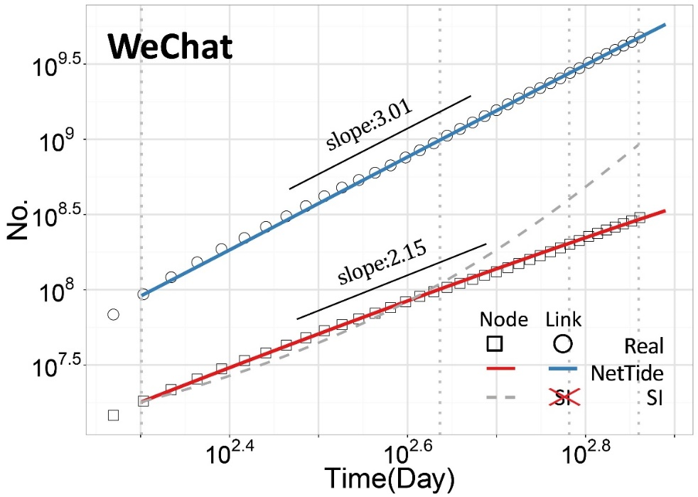
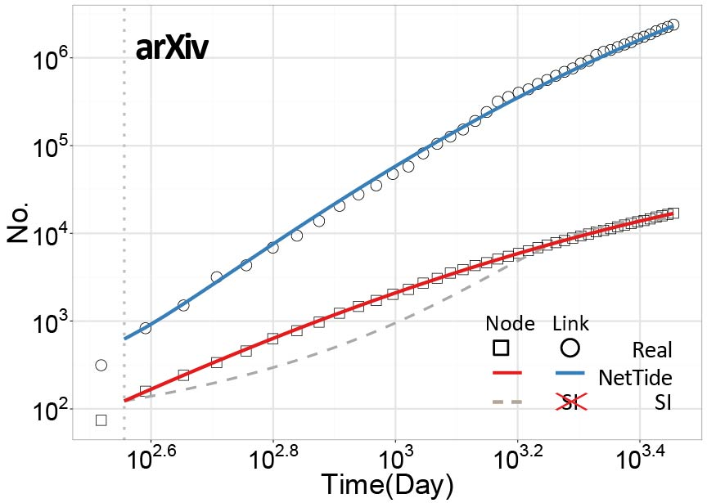
Findings: Power Law Growth
7
Power law growth!
Both for n(t) and e(t)!
Past models (ಥ _ ಥ) ...
Cumulative growth（Log-Log scale）
Notes:
The findings. We observe power law growth for both nodes and links, a fact that completely breaks the previous assumptions, like the sigmoid models. Specifically, we find the growth dynamics of WeChat follows power-law growth with exponent 2.15 for nodes and 3.01 for links (Fig 1a), and the growth dynamics of arXiv follows power-law like growth before hitting the plateaus (Fig 1b). These observations go far beyond our traditional expectations of network growth dynamics

Slide 8
NetTide Model
Node
Link
Notes:
In its place, we propose NETTIDE, along with differential equations for the growth of nodes, as well as links.

Slide 9
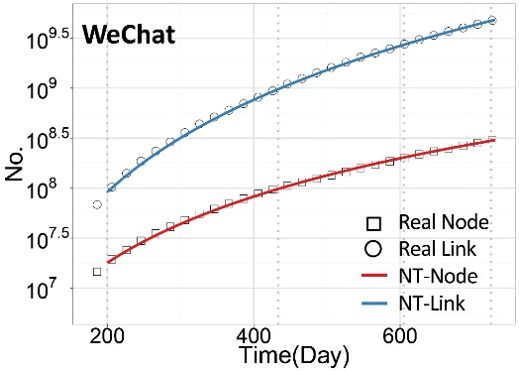
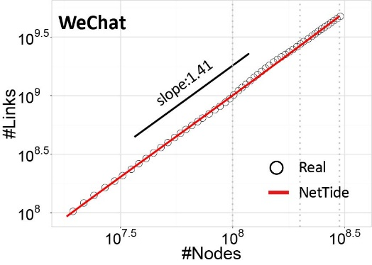
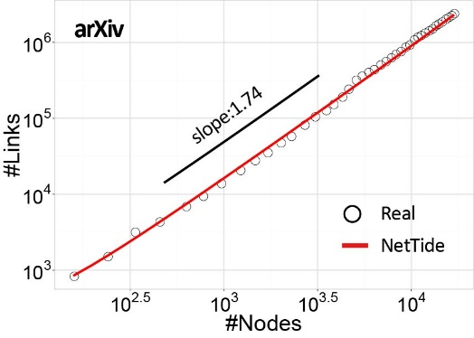
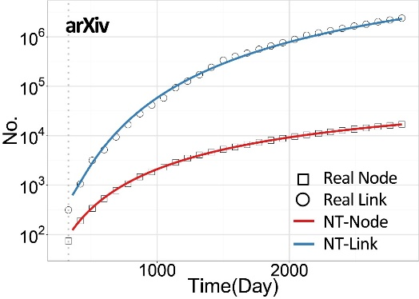
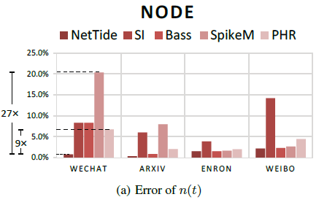
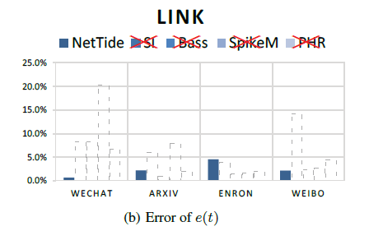
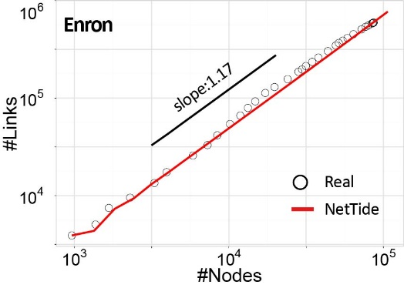
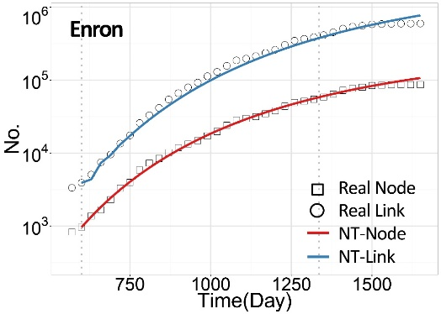
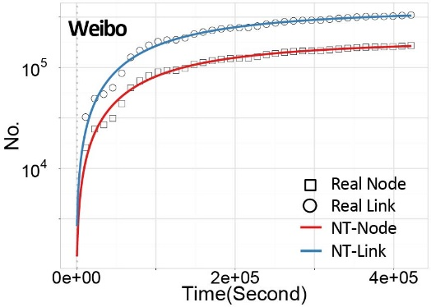
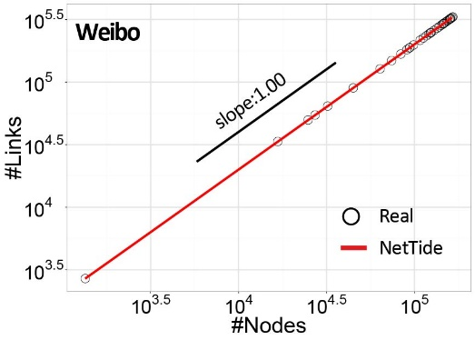
Results: Accuracy
Notes:
Let me first introduce the experiment results before going into the models.
We first validate the Accuracy. Can the NETTIDE accurately capture the growth dynamics of both node and link in real social networks?The answer is YES.
We examine the WeChat, arXiv [1], Enron [18] and Weibo [35],The checkpoints are node cumulative dynamics n(t), link cumulative dynamics e(t), and the densification of the links against the nodes e(nt).The NETTIDE accurately fits the growth patterns of real graphs;
(CLICK)We also consider other four methods. NetTide outperforms baselines. All these modesl are not appliable to links.

Slide 10
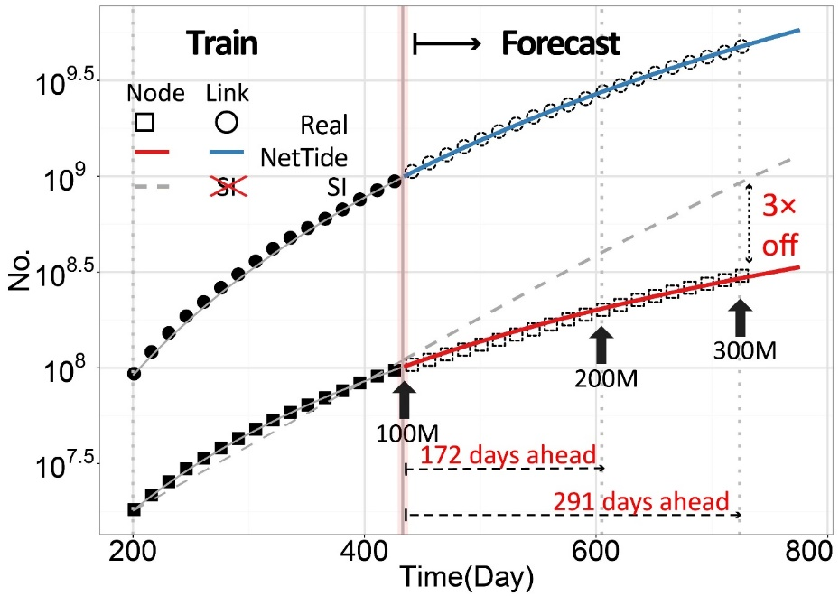
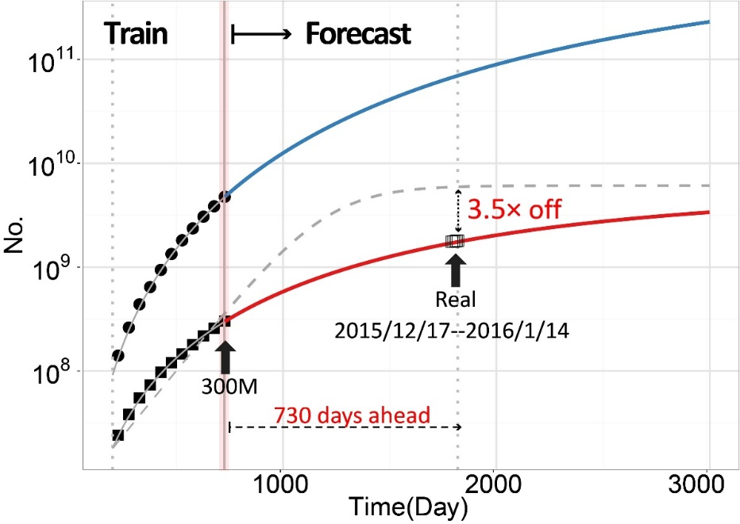
Results: Forecast
WeChat from 100 million to 300 million
730 days ahead
Notes:
Then, We show the practical value of our NETTIDE by forecasting both the count of nodes and links, in the short term and in the long term.
NetTide forecasts both near and far future well.
* As for the shorterm forecasting .Both NETTIDE-Node and NETTIDE-Link can forecast future dynamics very accurately, covering 291 days in the future for WeChat. and the arrival of some checkpoints marked as milestones (milestone forecasting task). E.g the time of doubling or tribling the population.
* Our NETTIDE also shows accurate forecasting results in the long term, 730 days into the future with 3% error for the WeChat case

Slide 11
NetTide-Node Model
$\frac{dn(t)}{dt}$ = $\frac{β}{t^{θ}}n(t)(N−n(t))$
Intuitions:
Rich-get-richer
Limitation
Fizzling nature
Notes:
Let me show you model details.
The NetTide Model
Node: A social network with a large population n(t) has a propensity to attract more nodes.
As the population who can join the social network is limited, its growth will be constrained
The term β/tθ (t > 0) is the fizzling infection/excitement rate since the inception of the social network. That is, people have decaying excitement to infect their friends to join a social network. It is exactly the temporal fizzling exponent θ of the power law decay that leads to various growth dynamics

Slide 12
NetTide-Node Model
$\frac{dn(t)}{dt}$ = $\frac{β}{t^{θ}}n(t)(N−n(t))$
LEMMA1: $θ=1$, Log-Logistic growth, Power-Law early-growth.
LEMMA2: $θ≠1$, Fizzle-Logistic growth, Fizzle-Exponential early-growth.
LEMMA3: $θ=0$ Sigmoid Growth, Exponential early-growth.
Like, SI, Bass (with innovator cutoff)
$$n\left(t\right)=N \frac{λ_{0}exp⁡\{\int_{t_{0}}^{t}{\frac{βN}{μ^{θ}}dμ}\} }{1+λ_{0}exp⁡\{\int_{t_{0}}^{t}{\frac{βN}{μ^{θ}}dμ}\}}$$
$$n\left(t\right)=n_{0}exp⁡\{\int_{t_{0}}^{t}{\frac{βN}{μ^{θ}}dμ}\}$$
Notes:
We find,
LEMMA 1. When θ = 1, NETTIDE-Node follows Log-Logistic growth dynamics, shown in equation **, which approximates the power law growth shown in equation ** with exponent βN when n(t) << N （far less than）
LEMMA 2. When θ ！= 1, NETTIDE-Node follows growth pattern as in equation ** When n(t) far less than N, the growth at early times behaves as equation **
LEMMA 3. When θ = 0, the NETTIDE-Node follows the Logistic growth dynamics, e.g. SI model, which is a special case of Lemma (2). When n(t) <<N, the Logistic growth approximates to the exponential growth as:

Slide 13
NetTide-Link Model
External links
Internal links
Underlying organizational structure
Modeled by Kronecker graph with $γ$ = lnE/lnN
Densification: scaling exponent 1+ $γ$
Notes:
Link:
* The arrival of new nodes will bring a constant number of external links.
* for each existing node i, i tries to link to his already existing neighbor j in G0 . If there is a link already being there, then nothing happens. If the link from i to j has not been established yet, i tries to link j with rate β 'prime over the temporal fizzling term tθ.
* We assume that there exists underlying organizational structure as the context of social network formation and growth. This underlying graph may be modeled by Kronecker graph, with r = lnE/lnN, and the densification power law exponent is 1+r

Slide 14
NetTide Process
Input $G_{0},β,β^{′},θ$
Output $G_{1}\left(t\right)=(Node\left(t\right), Link(t))$
Node growth
Link growth
Activity (easily embedded)
Notes:
Our model corresponds to a stochastic process. More details in journal version

Slide 15
Learning Process
Discrete Analogue
Levenberg-Marquardt algorithm
Notes:
Refs: In mathematics and computing, the Levenberg–Marquardt algorithm (LMA), also known as the damped least-squares (DLS) method, is used to solve non-linear least squaresproblems. These minimization problems arise especially in least squares curve fitting. The primary application of the Levenberg–Marquardt algorithm is in the least-squares curve fitting problem: given a set of {\displaystyle m} empirical datum pairs (x_{i}, y_{i}) of independent and dependent variables, find the parameters β of the model curve f(x, β) so that the sum of the squares of the deviations is minimized:
{\displaystyle {\hat {\beta }}=\operatorname {argmin} \limits _{\beta }S(\beta )\equiv \operatorname {argmin} \limits _{\beta }\sum _{i=1}^{m}[y_{i}-f(x_{i},{\boldsymbol {\beta }})]^{2}.}

Slide 16
Conclusions
Power-law growth for nodes and links.
Novel NetTide Model
Parsimonious, All encompassing, Link Growth, Interpretable.
Accurate Fitting
Forecasting 730 days head!
Notes:
In all, we find the power growth for nodes and links of the real social networks. And we propose NETTIDE model， which is
* parsimonious, requiring only a handful of parameters.
* general, encompassing as special cases all the known, traditional models (including Bass, SI, log-logistic growth)
link equation is the first one of its kind,
* accurate in fitting the real SN growth,
* useful in forecasting.

Slide 17
Thanks!
Chengxi Zang
calvin-zcx@qq.com

