Slide 1
Differential Deep Learning on Graphs and its Applications
Chengxi Zang and Fei Wang
Weill Cornell Medicine
www.calvinzang.com

Slide 2
This Tutorial
www.calvinzang.com/DDLG_AAAI_2020.html
AAAI-2020
Friday, February 7, 2020, 2:00 PM -6:00 PM
Sutton North, Hilton New York Midtown, NYC

Slide 3
This Tutorial
✓
Molecular Graph Generation: to generate novel molecules with optimized properties
Graph generation
Graph property prediction
Graph optimization
Learning Dynamics on Graphs: to predict temporal change or final states of complex systems
Continuous-time network dynamics prediction
Structured sequence prediction
Node classification/regression
Mechanism discovery: to find dynamical laws of complex systems
Density Estimation vs. Mechanism Discovery
Data-driven discovery of differential equations
✓
✓

Slide 4
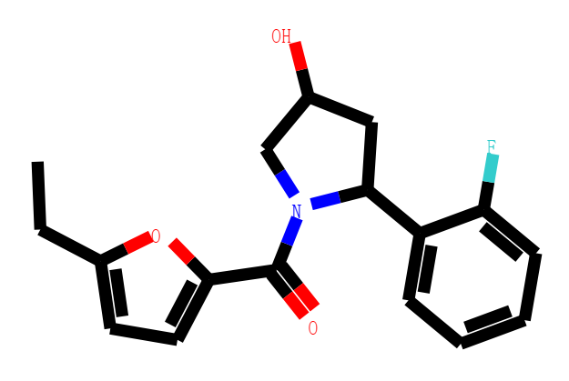
Molecular Graph Generation
Goal: To generate novel molecules with optimized properties
Graph Analysis tasks
Graph generation: $G \sim P(G)$
Graph property prediction: $f(G)$
Graph optimization: $G$→ $G′$ and $maximizing$ $f\left(G^{′}\right)−f(G)$
P ( ) ?
f ( )=?

Slide 5
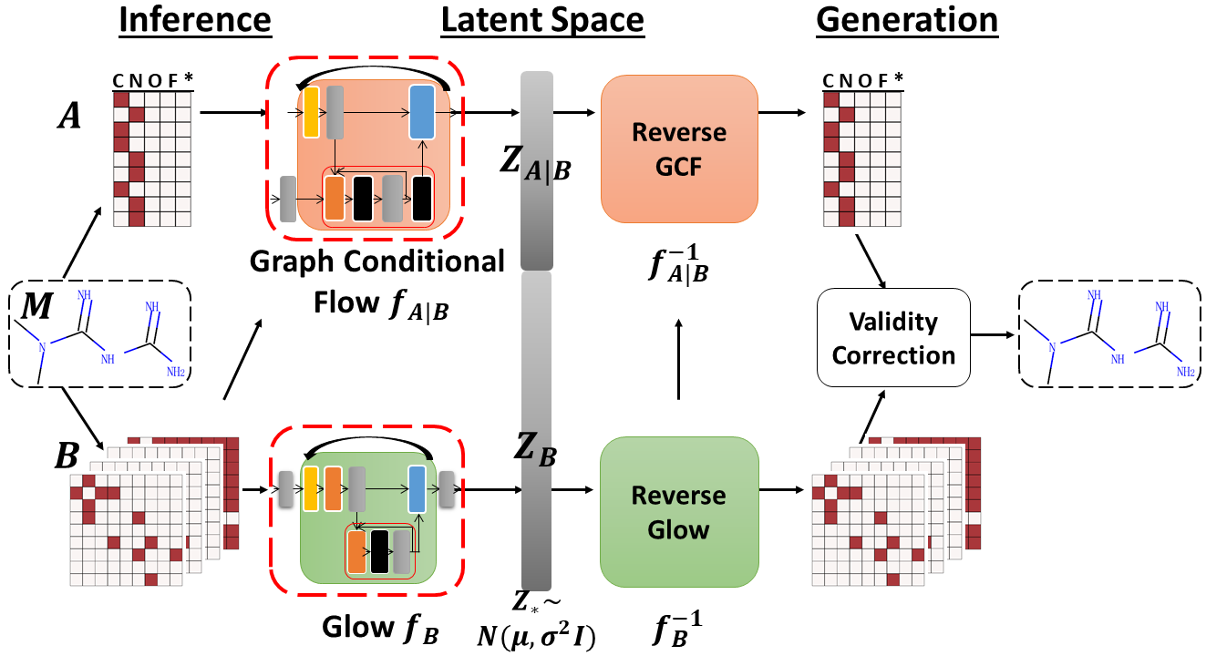
MoFlow: An Invertible Flow Model for Generating Molecular Graphs

Slide 6
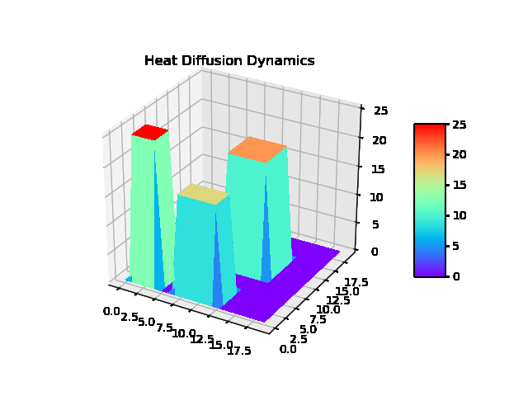
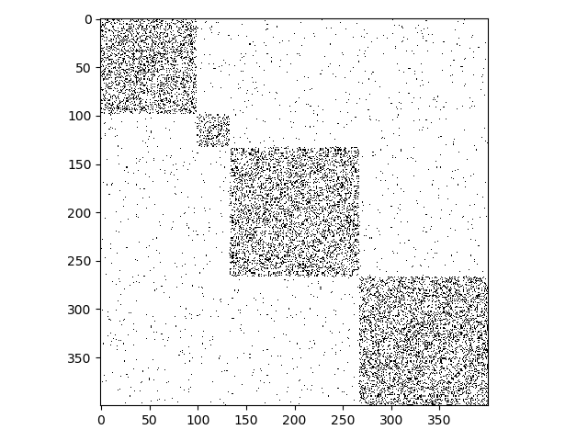
Learning Dynamics on Graphs
Goal: To predict temporal change or final states of complex systems
Graph Analysis tasks
Continuous-time network dynamics prediction $X(t)$
Structured sequence prediction $X[t+1]$
Node classification/regression $Y(X(T))$
Adjacency Matrix
+
Dynamic
Process
Dynamics of each nodes
Graph
?

Slide 7
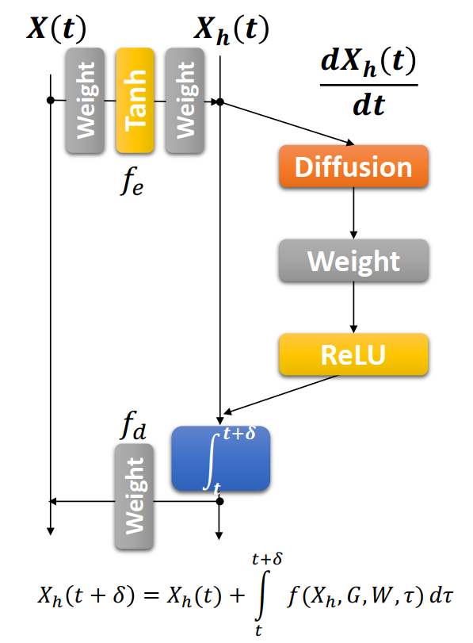
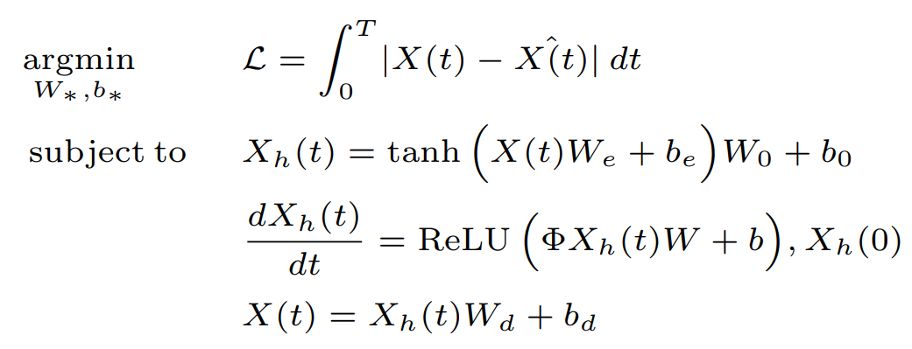
Neural Dynamics on Complex Networks
Our Model :
Argmin $L=\int_{0}^{T}{|X\left(t\right)− \hat{X(t)}|dt}$
S.t. $X_{h}\left(t\right)=tanh\left(W\left(t\right)W_{e}+b_{e}\right)W_{0}+b_{0}$
$\frac{dX_{h}(t)}{dt}=ReLu\left(φX_{h}\left(t\right)W+b\right), X_{h}\left(0\right)$
$X\left(t\right)=X_{h}\left(t\right)W_{d}+b_{d}$
Notes:
Graph Neural Network like structure for Diffusion
Diffusion in the hidden space

Slide 8
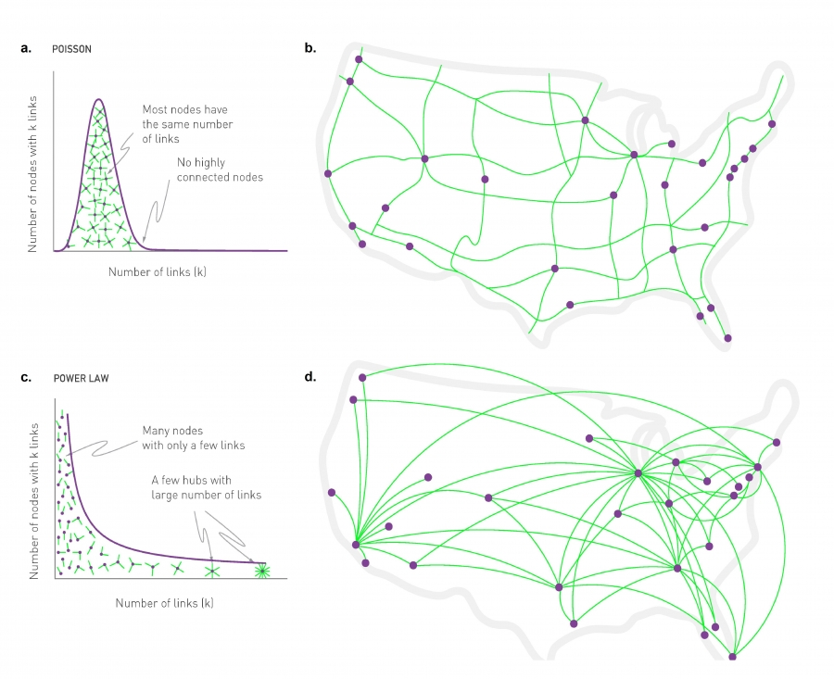
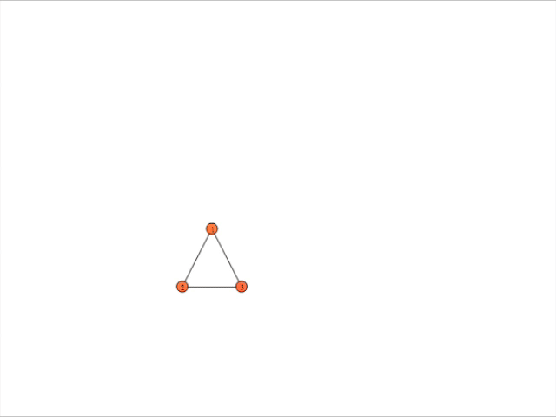
Mechanism Discovery
Goals: To find dynamical laws of complex systems
Graph Analysis tasks
Density estimation vs. mechanism discovery
Data-driven discovery of differential equations
?
$$\frac{dX}{dt}$$
Image from http://networksciencebook.com/chapter/4#hubs

Slide 9
Dynamical Origins of Distribution Functions
9
Distribution
A theorem constructing dynamic systems described by Differential Equations which generate the observed distribution
Data
Survival
Analysis
Dynamic System
ODE
Stochastic, linear
Deterministic, nonlinear
Complex Pattern
Backward: system identification/Learning
Forward: data generation
Input
Dynamical system
Output
Notes:
We conclude our work Learning and Interpreting Complex Distributions in Empirical Data here:
We develop parametric tools to fit various complex empirical distributions by leveraging a unified and simple hazard function in survival analysis. We then give a generative interpretation of the data in a dynamic system view. In a word, we try to connect the dots as shown in the plot. Possible further works are: we can construct more complex distributions by our framework, we can infer dynamics from non-parametric distribution models, and by applying this framework, we can further investigate the generative dynamics of existing distribution and empirical datasets. Codes and datasets will be found on my website later.

Slide 10
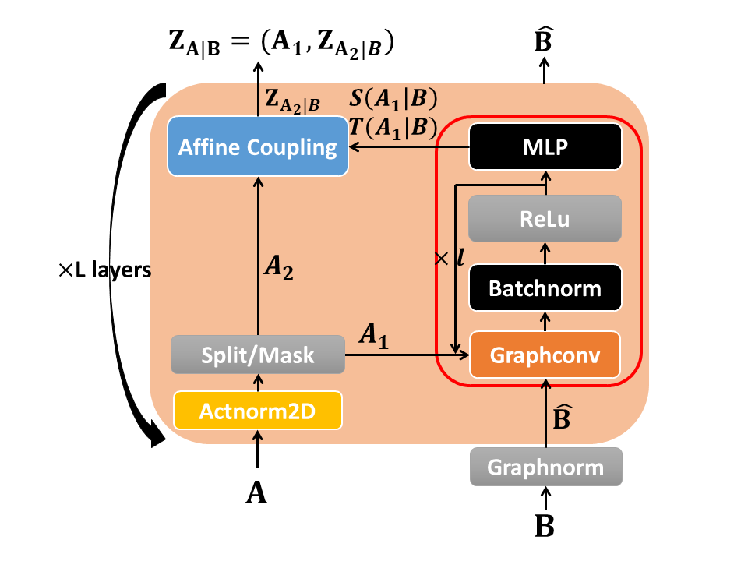
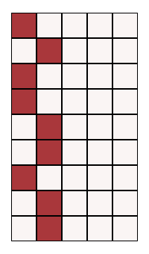
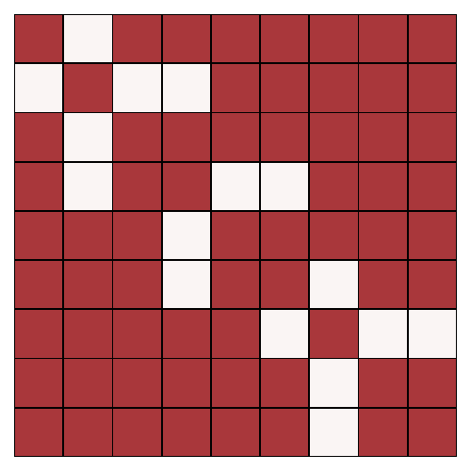
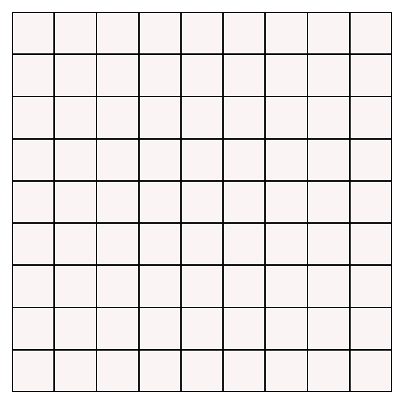
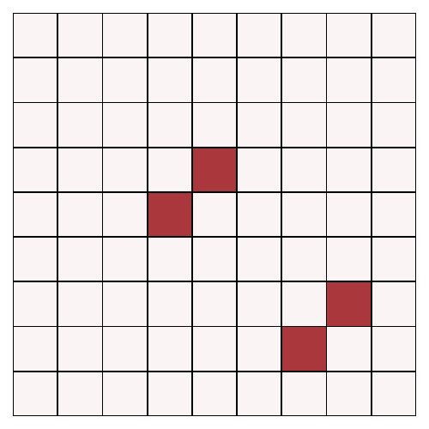
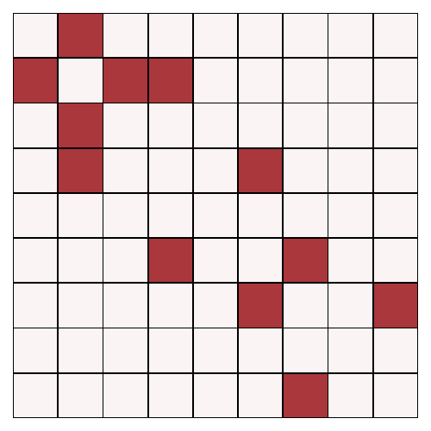
Some Practical Tips
Data preprocessing
Padding null atoms, augmenting null edges
Normalization matters
Graphnorm, batchnorm, actnorm
Stable flows with less reconstruction error
Normalization, sigmoid, checking each layer
Discrete mapping is faster than integration
Split and coupling layer are very efficient invertible framework for graph convolution
Visualizing dynamics on graphs
Thinking physical meanings of differential equations
C N O F *

Slide 11
Differential Deep Learning on Graphs
Graphs and Differential Equations are general tools to describe structures and dynamics of complex systems
Inspired by the Differential Equations, we can design and analyze Deep Models
For applications on graphs (our focus), including:
Molecular Graph Generation
Learning dynamics of complex systems
Mechanism discovery
in a data-driven manner
Notes:
Graphs/networks
Differential Equations, difference equations etc.
区分 方法 和 应用
Molecular graph generation
Traffic prediction
Molecular Graph Generation
Learning dynamics of complex systems
Mechanism discovery

Slide 12
More Directions
Deep Learning → Differential Equations
Analysis
Math analysis tools
Concepts in dynamic system and control: stability, robustness, complexity, resilience, etc.
Modeling Continuous-time process
Physical meaning. The laws of nature are expressed as differential equations.
Differential Equations → Deep Learning
Design
There are many dynamical systems and differential equations.
Discretization of continuous time-varying neural dynamics → Deep Neural Networks
DNNs implemented by modern auto-differentiation softwares are more flexible, expressive and efficient
Generative models and Invertible structures
Notes:
Forward mapping → Forward integration
Forward integration → Forward mapping

Slide 13
More Directions
Applications
Network medicine
Drug discovery
Molecular dynamics
Urban computing
Social networks
Recommendation
Etc. (structures + dynamics)

Slide 14
Thank You!
Differential Deep Learning on Graphs and its Applications
Chengxi Zang and Fei Wang
Weill Cornell Medicine
www.calvinzang.com

